Slide 1

Netention
Semantic
Business
Intelligence
An interactive tool that people can use to monitor the progress and state of their businesses.
"sim business"
(a serious computer game)

Slide 2
Inputs ("Expense"):
Resources, Money, People, Time, Attention
Outputs ("Income"):
Profits / Achievements Accomplishments / Products / Rewards
... the improvement made in reality
Created products and services are actually "income" - when sold, they "become" the money received, which is also "income".
Income: ____
Expenses: ____
Profit? Loss?
Notes:
https://en.wikipedia.org/wiki/Break-even

Slide 3
Business Plan
Ideally, what do we expect "success" to look like in "x" number of years?
Describe why your company is relevant. What is the need being addressed?
Explain the overall state of the market and any important trends.
Explain why customers will buy your product or service.
Describe, in detail, who your customers are.
Explain who your current competitors are and their advantages.
Explain which competitors you will displace.
Describe your product offerings, how they compete with other brands and why they are needed.
Provide an overview of the various resources, including the people that will be needed to deliver what’s expected by the customer.
Describe corporate priorities and the processes to achieve them.
Included three thorough financial plans; one that’s conservative, one moderate and one optimistic, each with realistic and achievable sales revenues, margins, expenses and profits on a monthly, quarterly and annual basis.

Slide 4
Inputs ("Expense"):
What we received, when, and from where
Resources, Money, People, Time, Attention
Outputs ("Income"):
Profits / Achievements / Products / Rewards ... the improvement made in reality
Actual
ASSETS
Resources Acquired /
Held
What we need
(shopping list)
When we need it
(recurring schedule with manual delay overrides)
Where it may come from
(CRM)
What we can provide
Potential

Slide 5
ok good start. can you try to merge CRM (customer relations management) into this. it's basically a system for tracking customers. these would supply potential inputs / resources. so taking the list of elements you found, try to simplify them as much as possible because each one will roughly correspond to its own section of the user-interface, which we want to minimize the number of them.
i've used business plan software before and it was extraordinarily complex to me. i want this to be simple for both operating existing AND simulating potential business. that's why i divided it into actual and potential, so that they can be morphed into each other as necessary.
for example i might design some "potential" products (including their ingredients or input resources) and then later move them to "actual", ie. i begin trying to acquire them for my production. the same for any kind of material fabrication process, and the same for any kind of abstract service (gathering people, arranging an education curriculum, etc..).

Slide 6
a complete business plan. note that it may not necessarily resemble a conventional business plan. i am just trying to make sure that all of the main components of it are present.
this is an opportunity to redefine what business actually is, and the way people think about it.
imagine an interactive overview screen that people can use to monitor the progress and state of their businesses. if you were to take a screenshot of it and print it, it would function the same as a business plan that one would show to an investor to convince them that a business is profitable.

Slide 7
netention as a tool could allow us to adaptively focus on whichever goals are most important at any given time. this way we can collectively manage MANY "businesses" in a coherent framework.
for netention we will want to adapt the best features of "open source business models":
http://en.wikipedia.org/wiki/Business_models_for_open-source_software
which if i remember correctly are primarily service (not product) oriented. this allows the software to be distributed and developed freely while services such as installation, training, and development work can be purchased

Slide 8
Item Editor
name
desc
Count
image
(drag here to upload)
Weight
Location
(40.3, -40.2) <Default>
Other Tag
Other Prop
SAVE

Slide 9
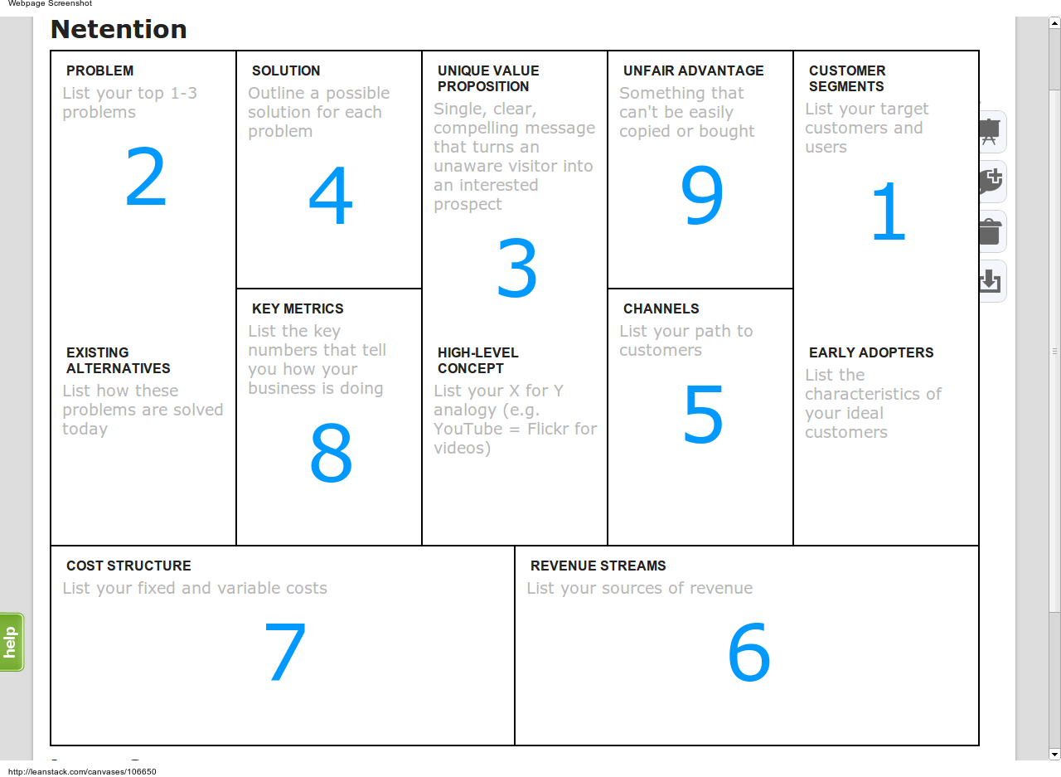
LeanStack.com

Slide 10
Screenshots from:
SENSORICA Value Network
http://valnet.webfactional.com

Slide 11
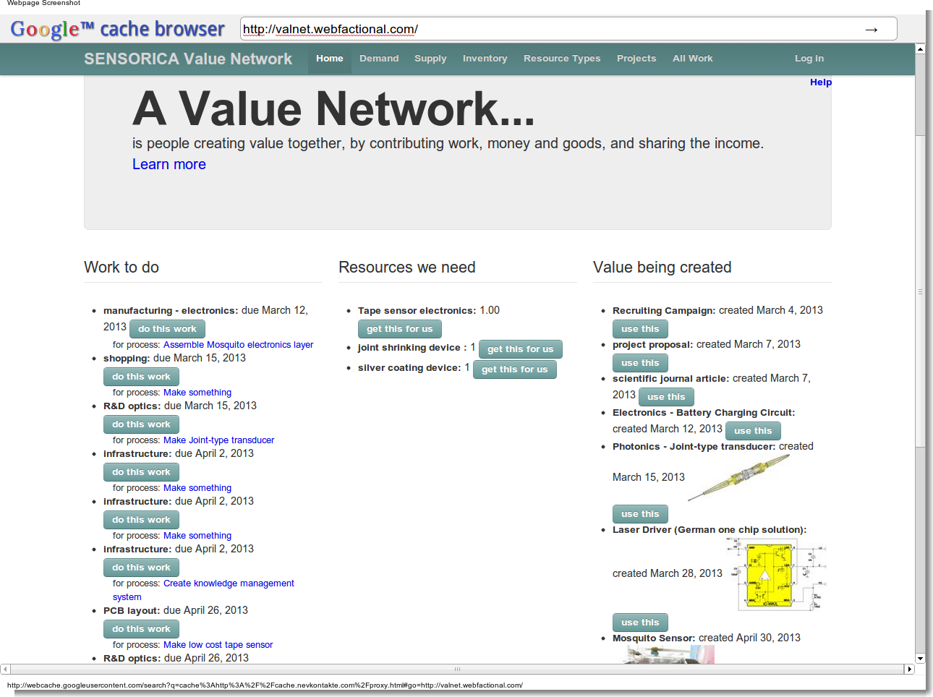

Slide 12
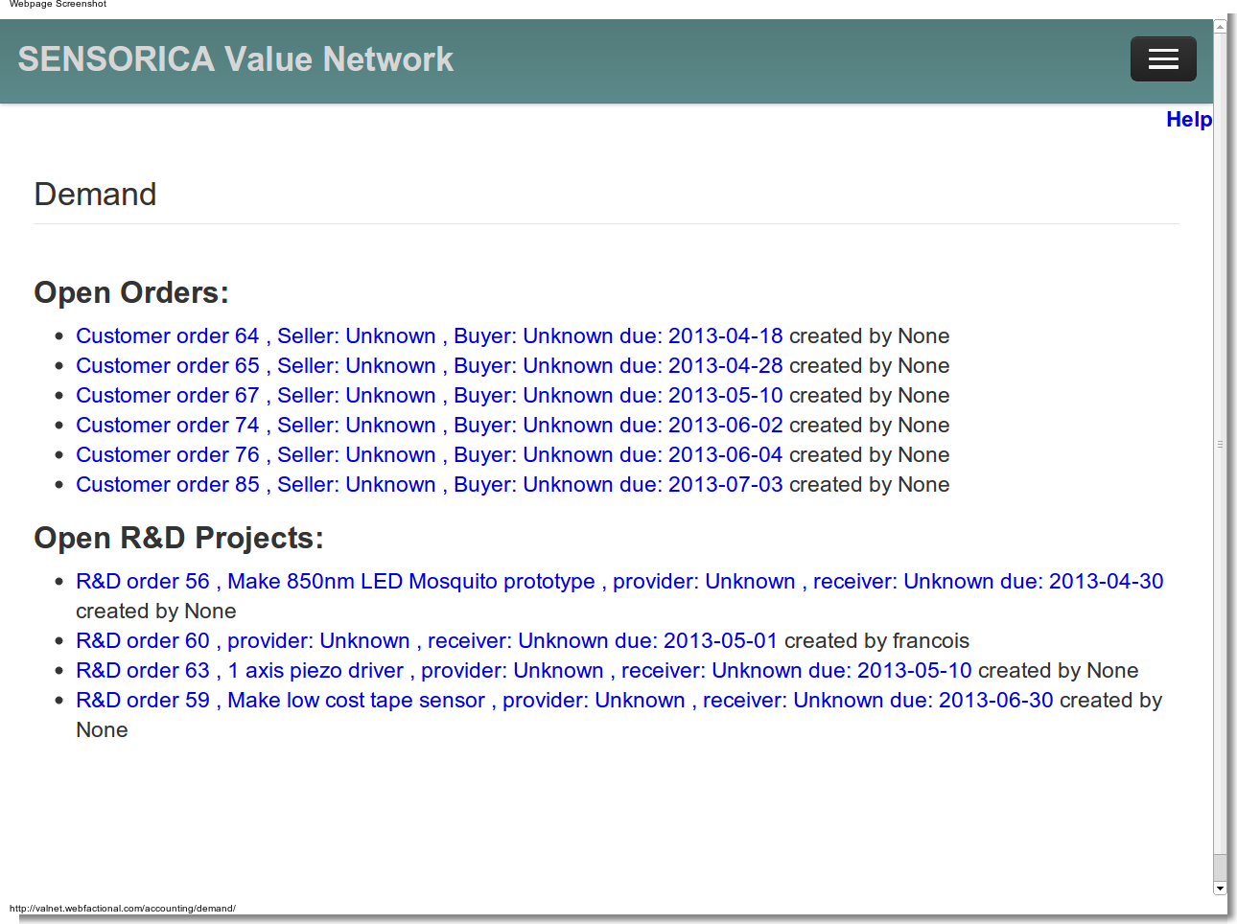

Slide 13
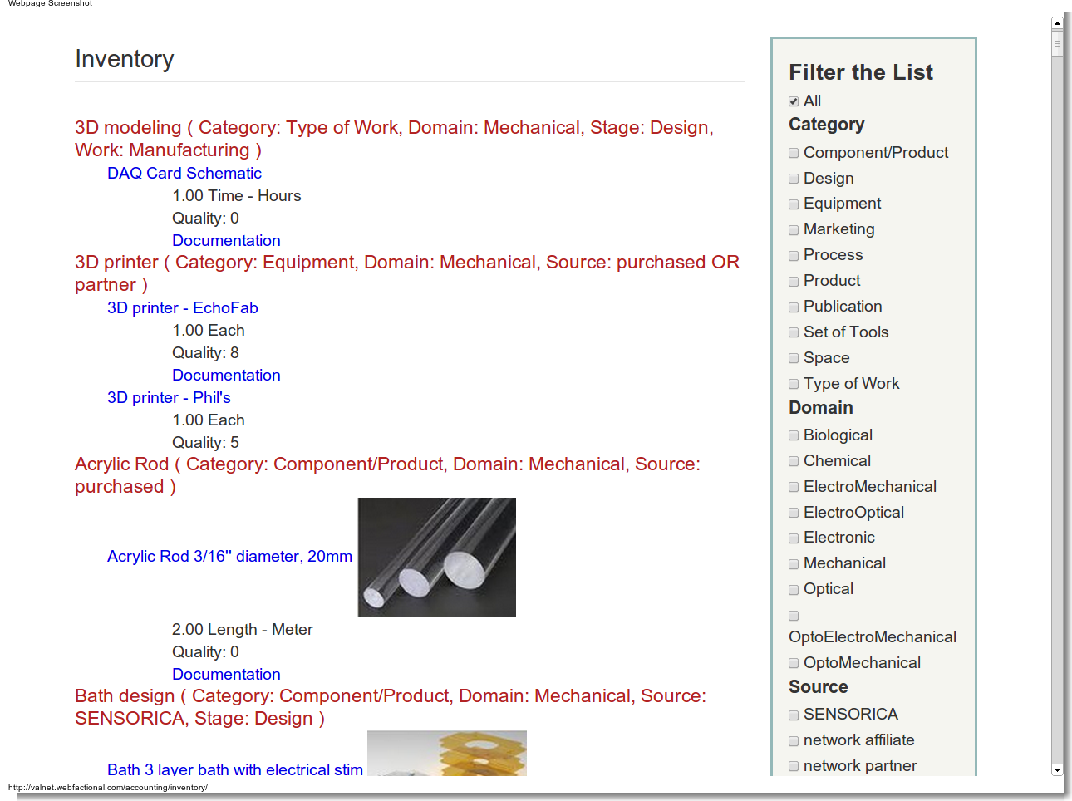

Slide 14
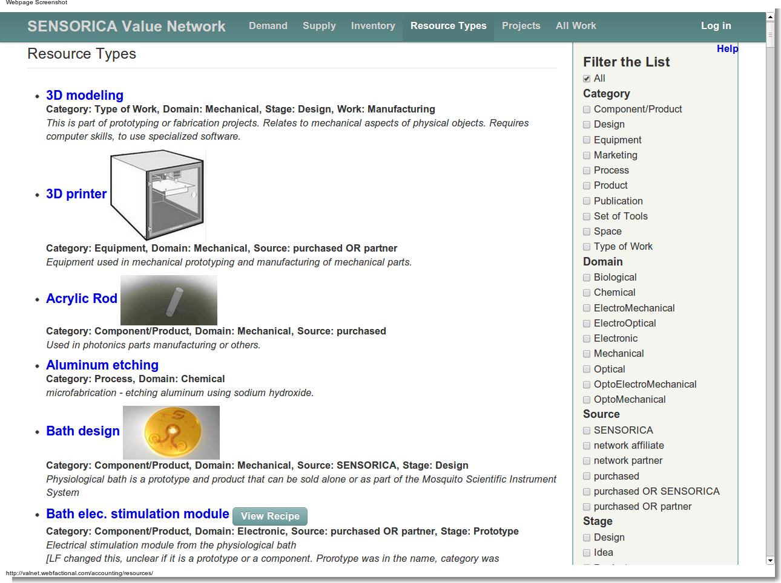

Slide 15
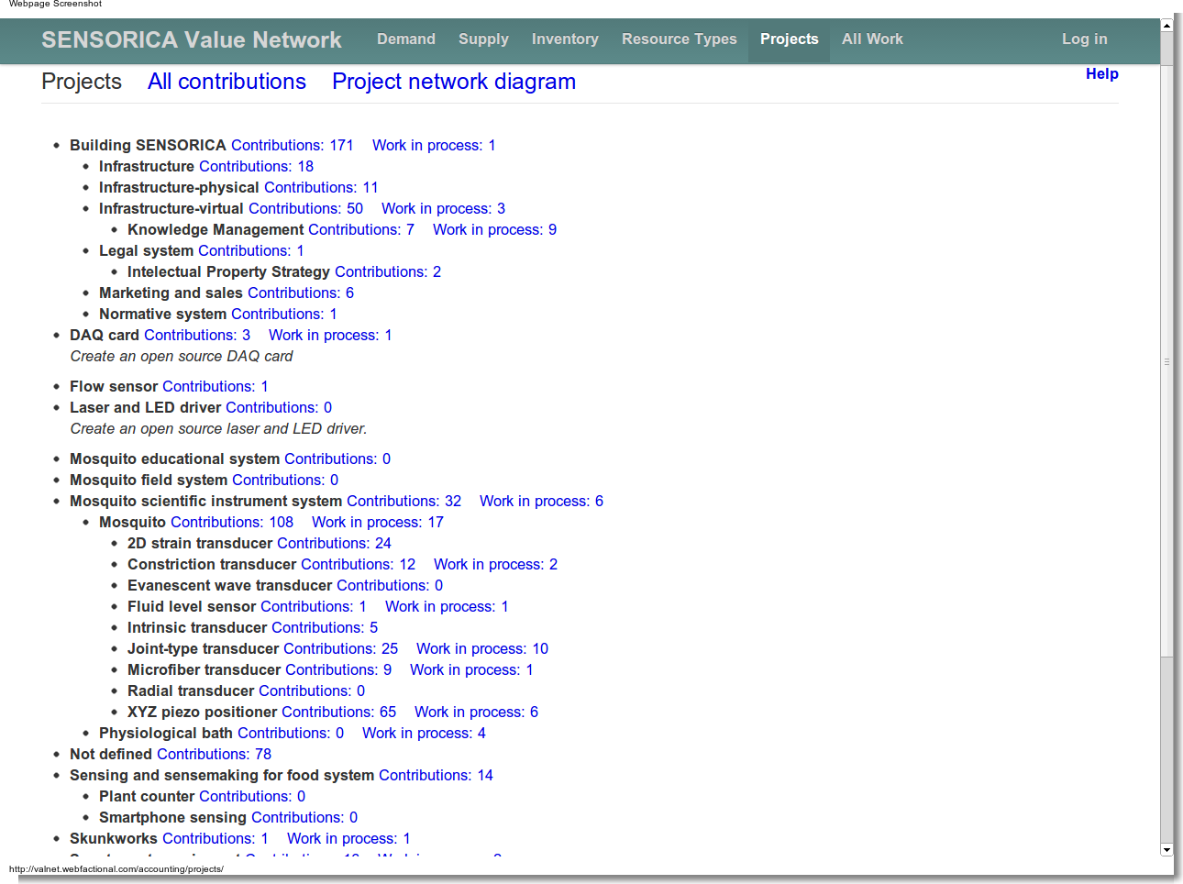

Slide 16
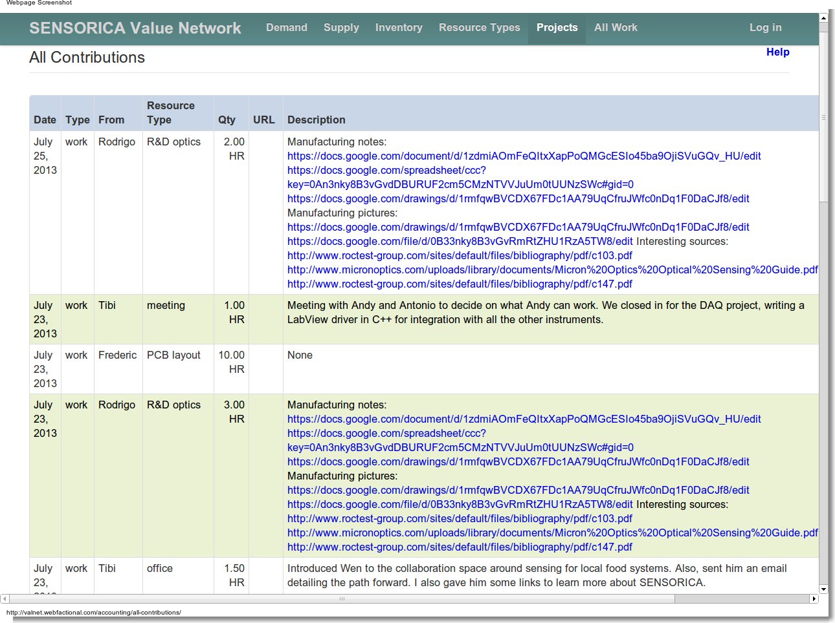

Slide 17
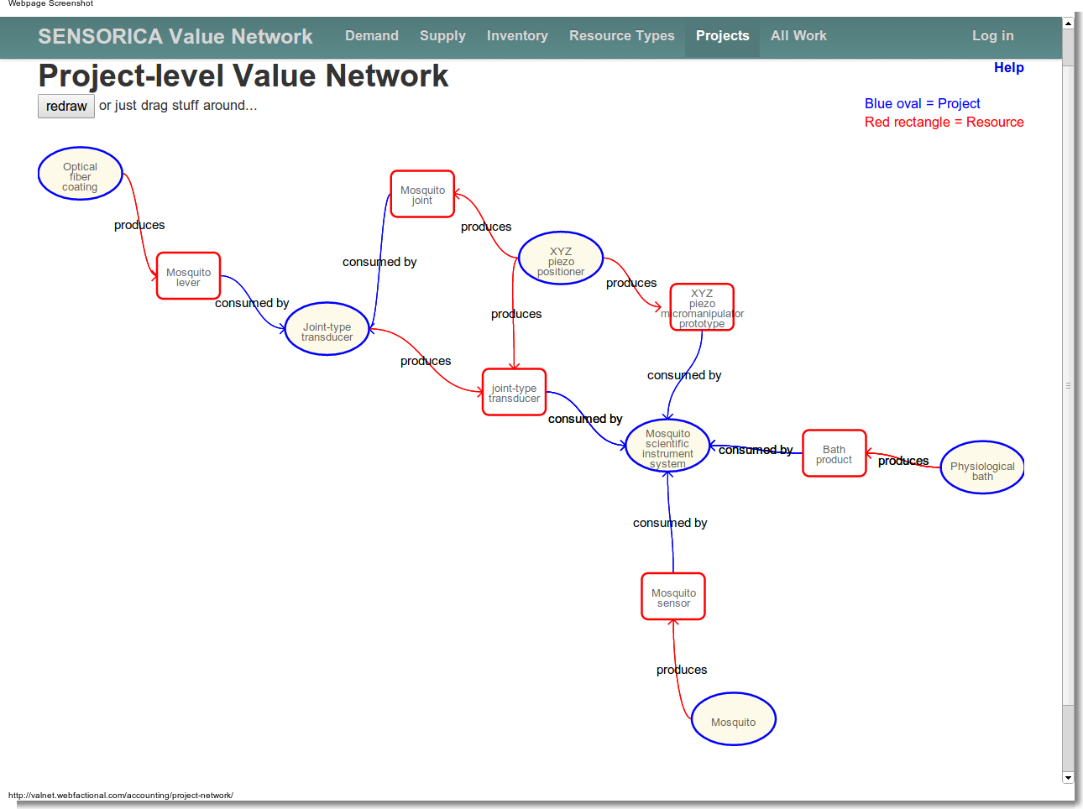

Slide 18
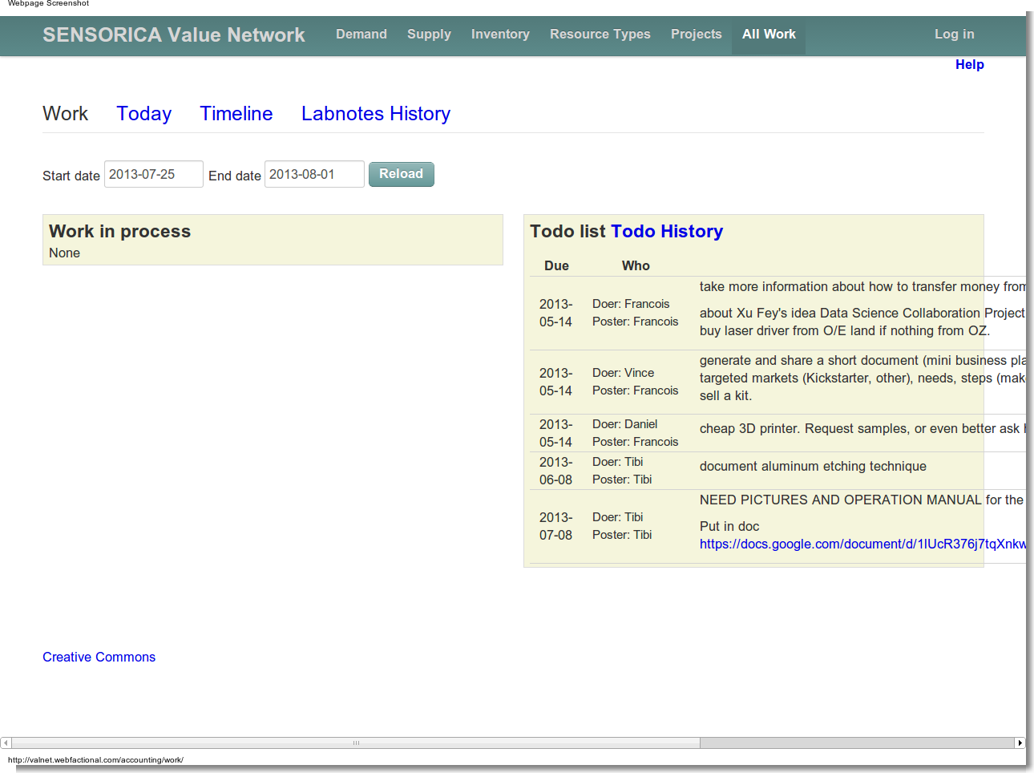

Slide 19
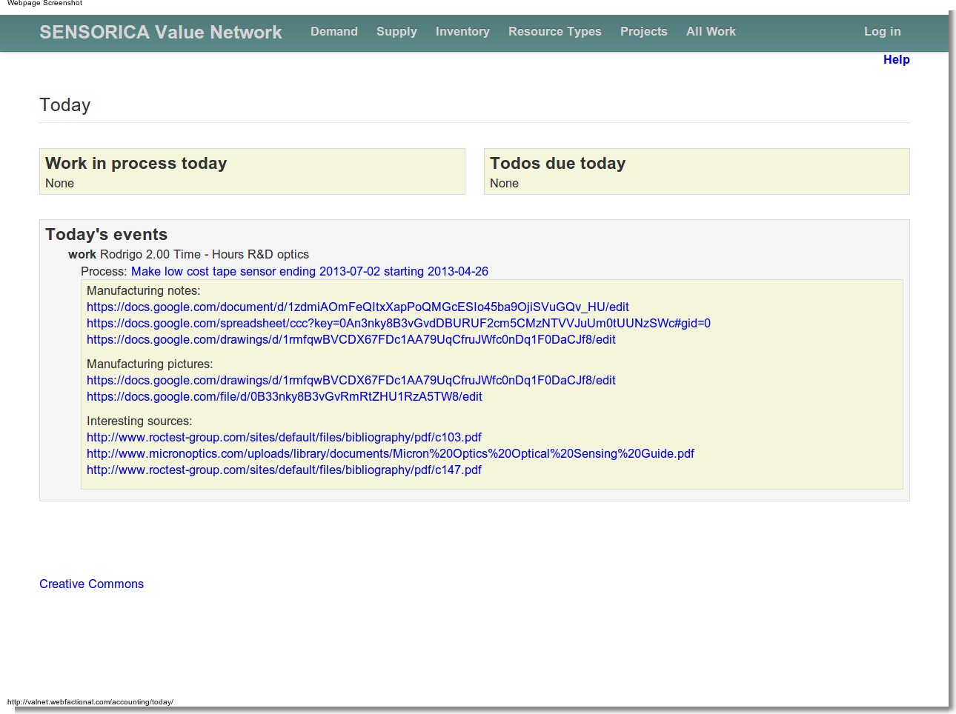

Slide 20
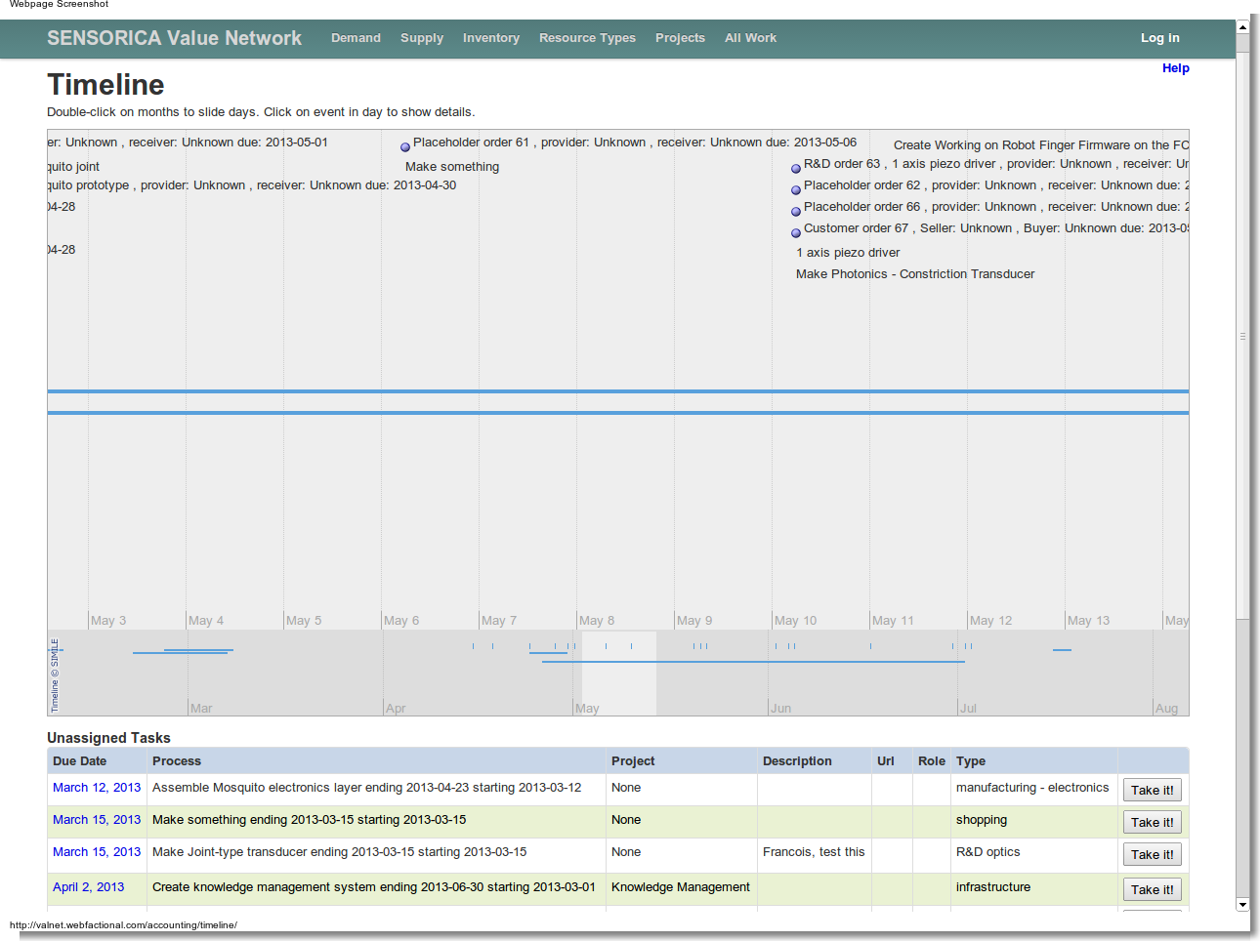

Slide 21
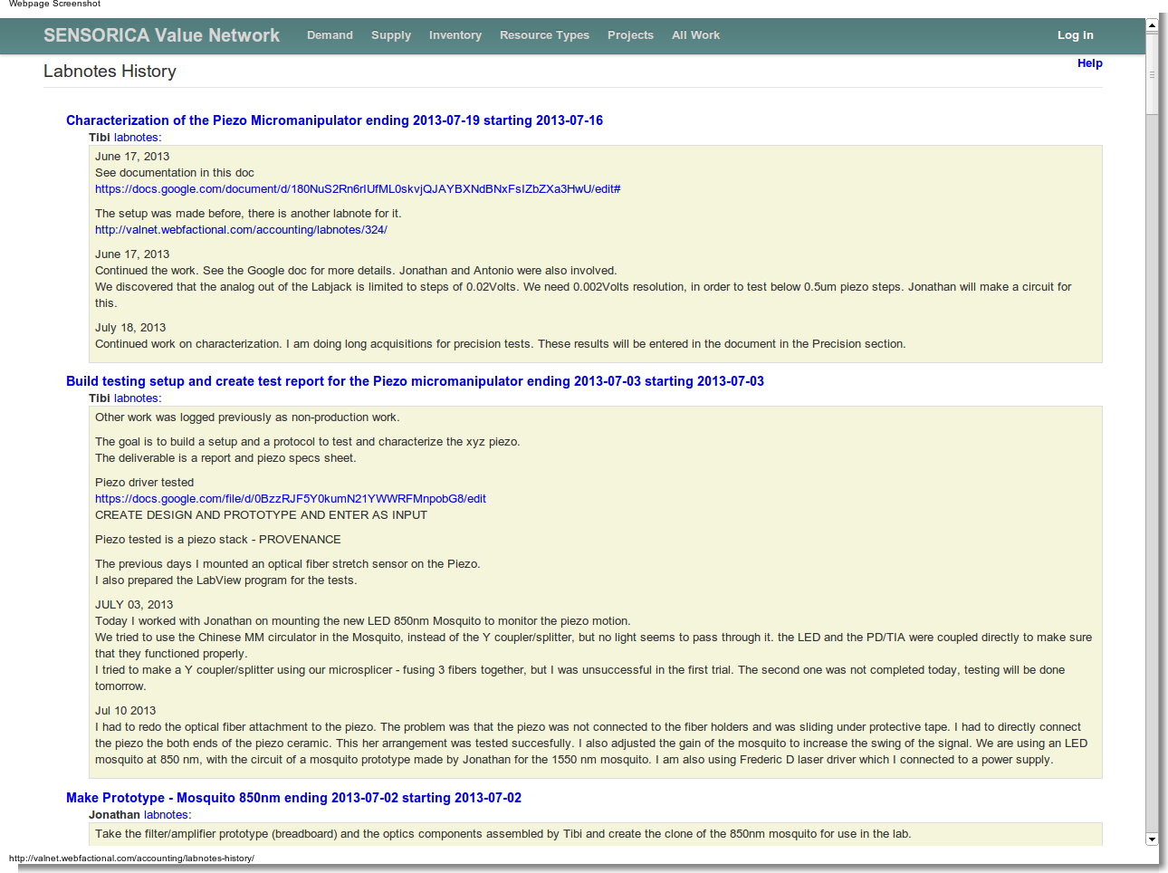

Slide 22
Screenshots from:
Local Economic Development
http://www.LOCECON.org

Slide 23
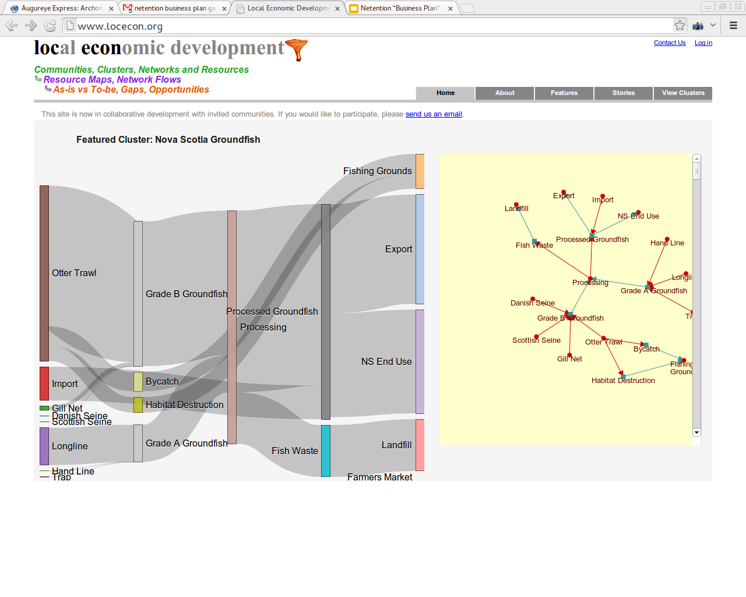

Slide 24
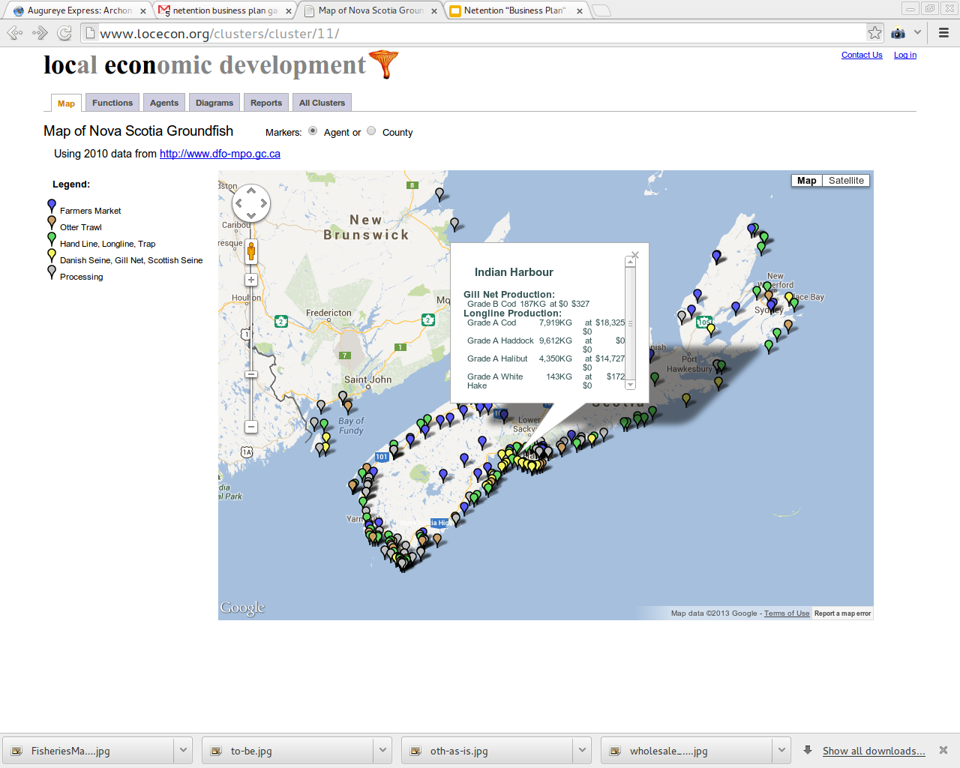

Slide 25
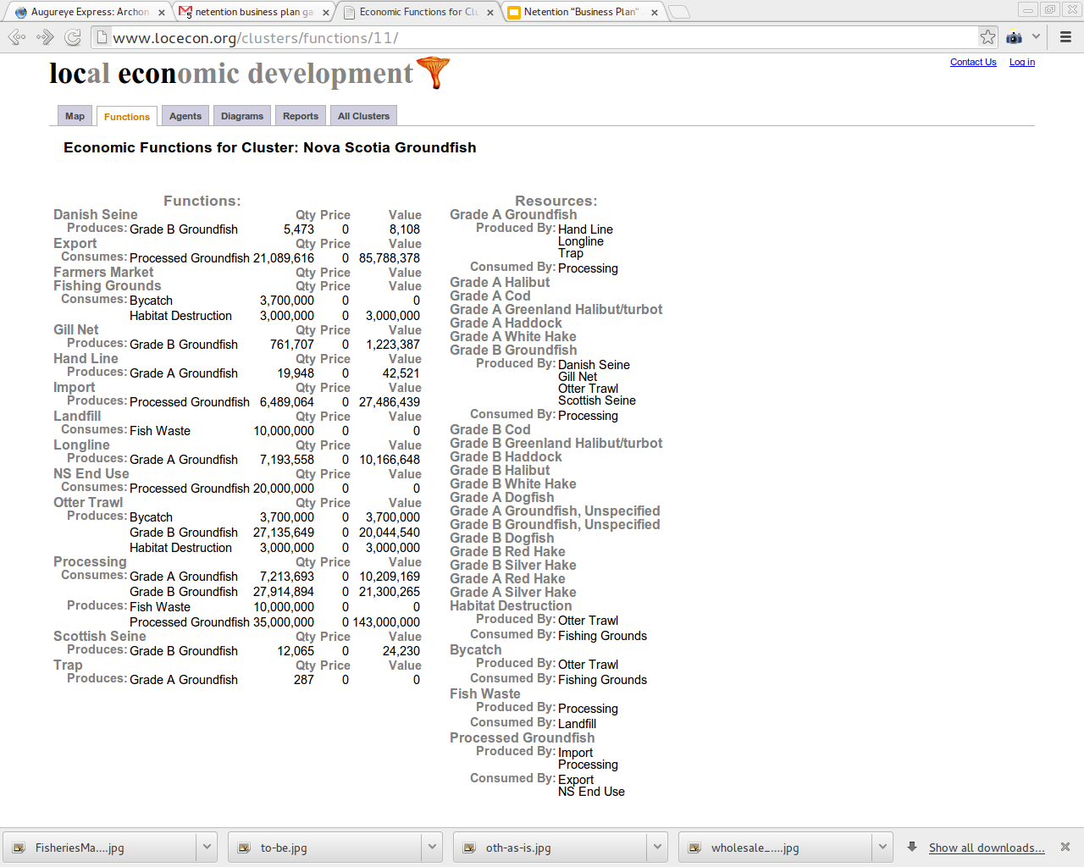

Slide 26
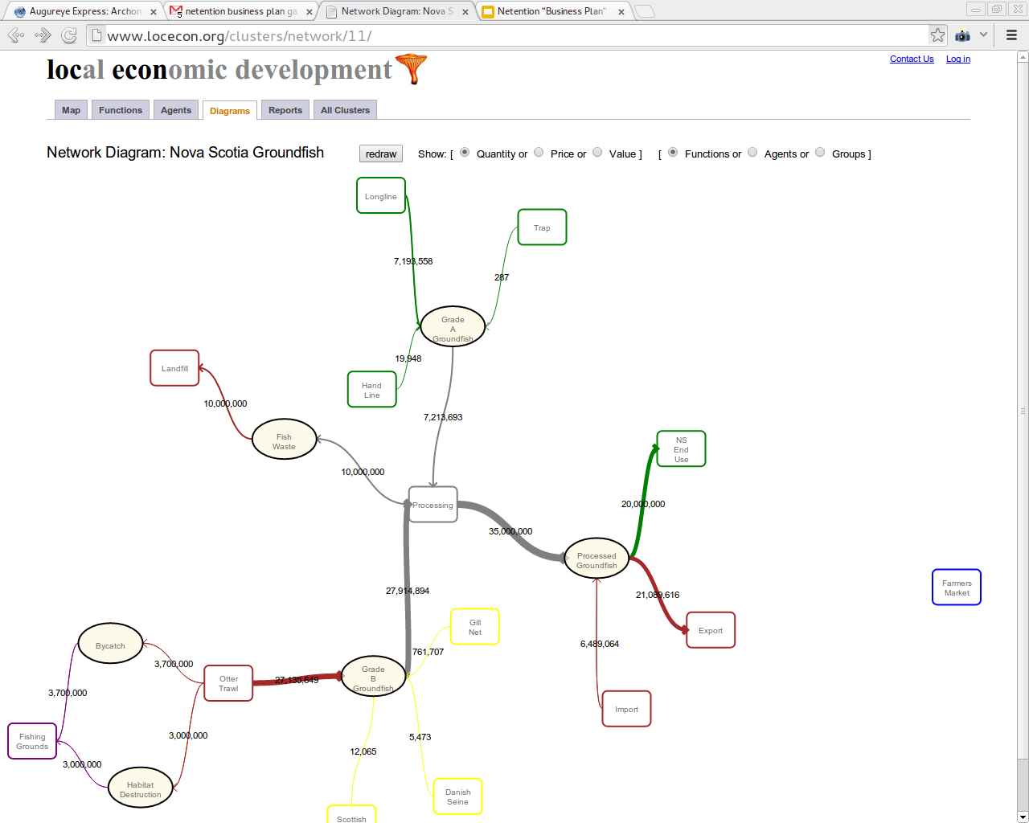

Slide 27
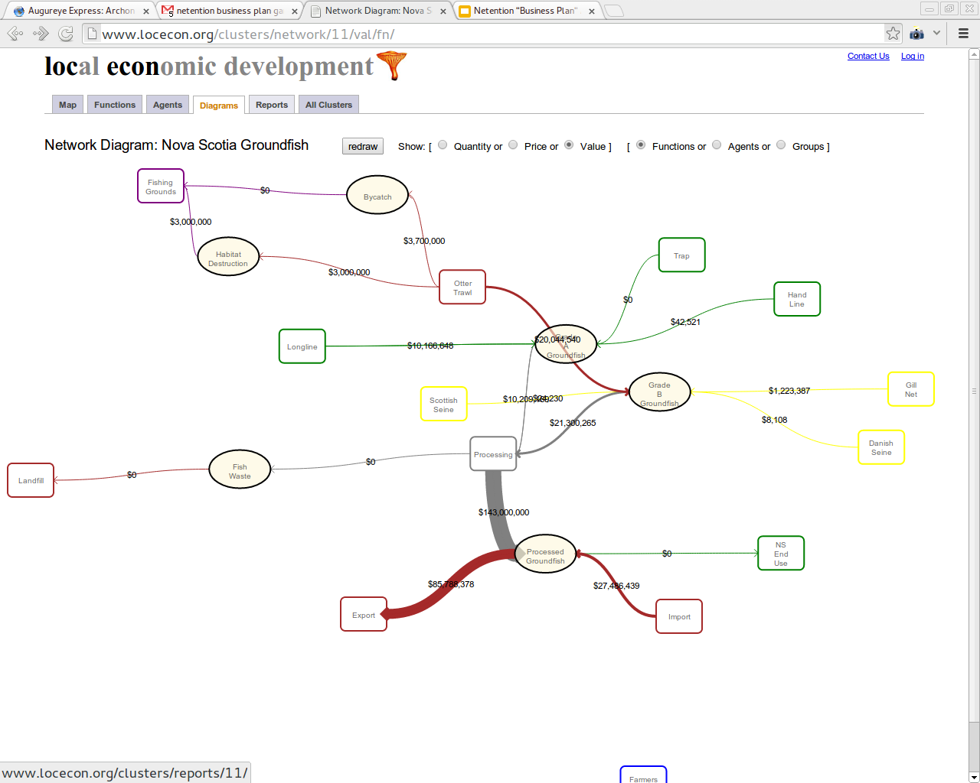

Slide 28
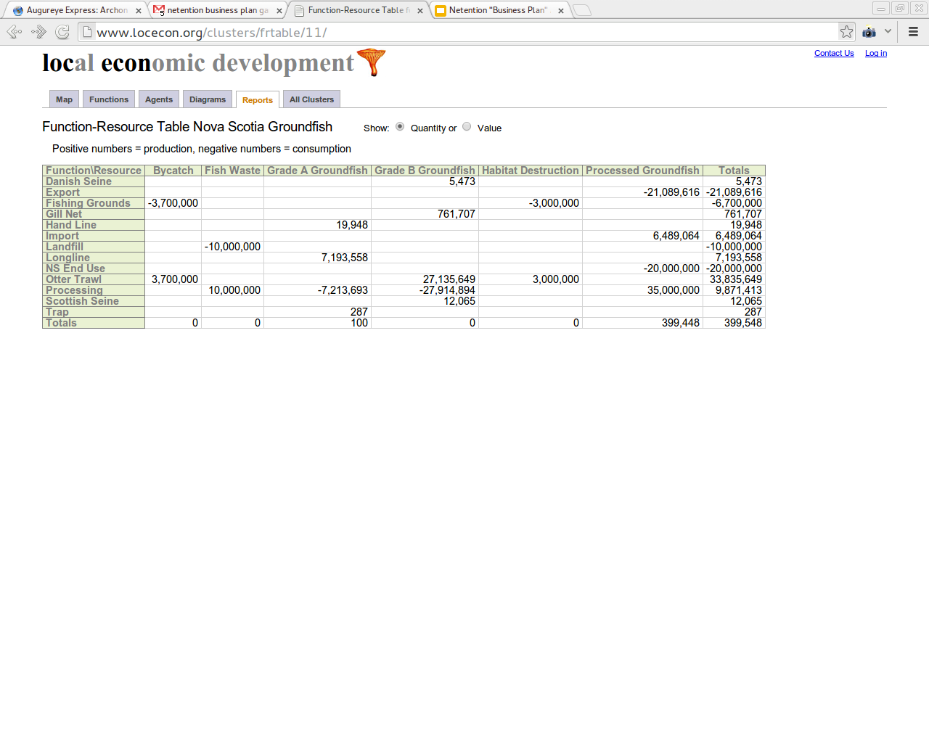

Slide 29
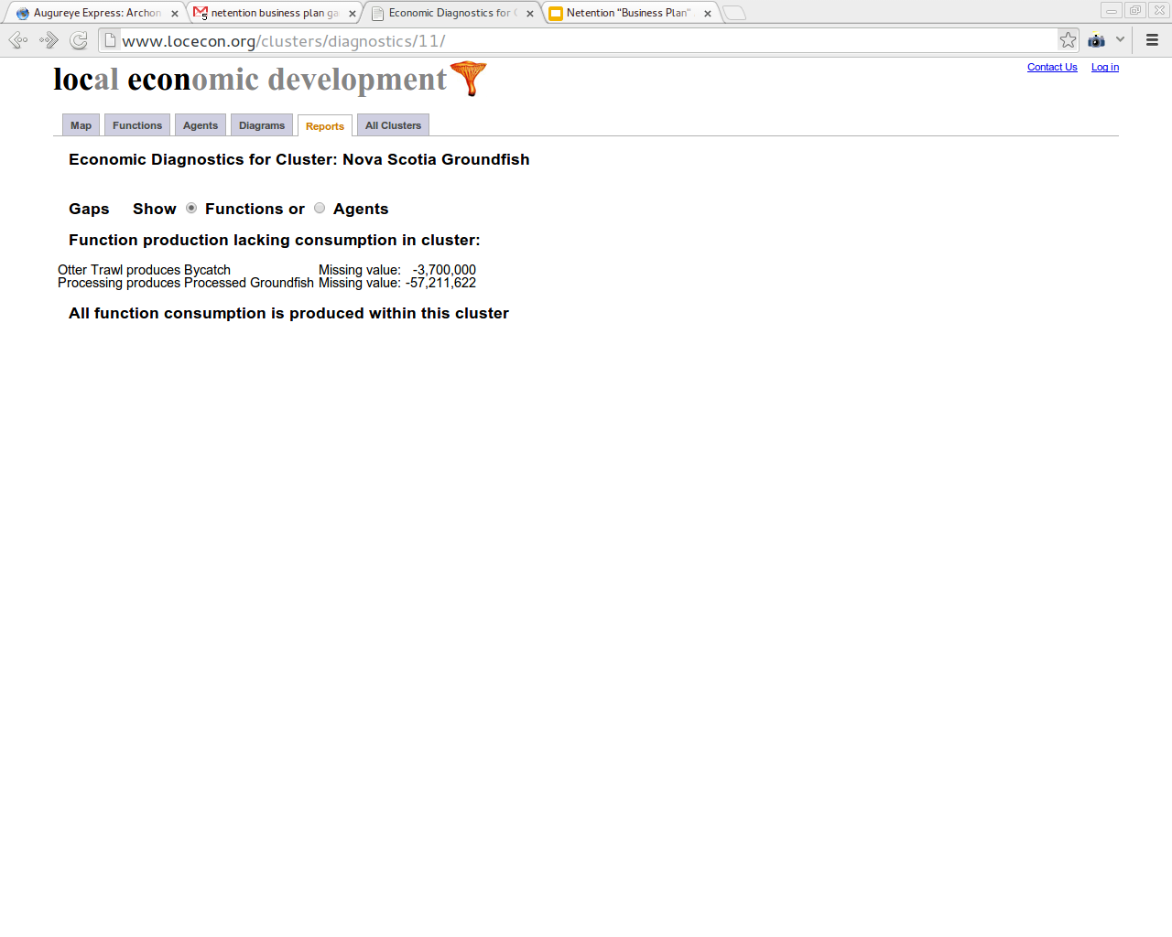

Slide 30
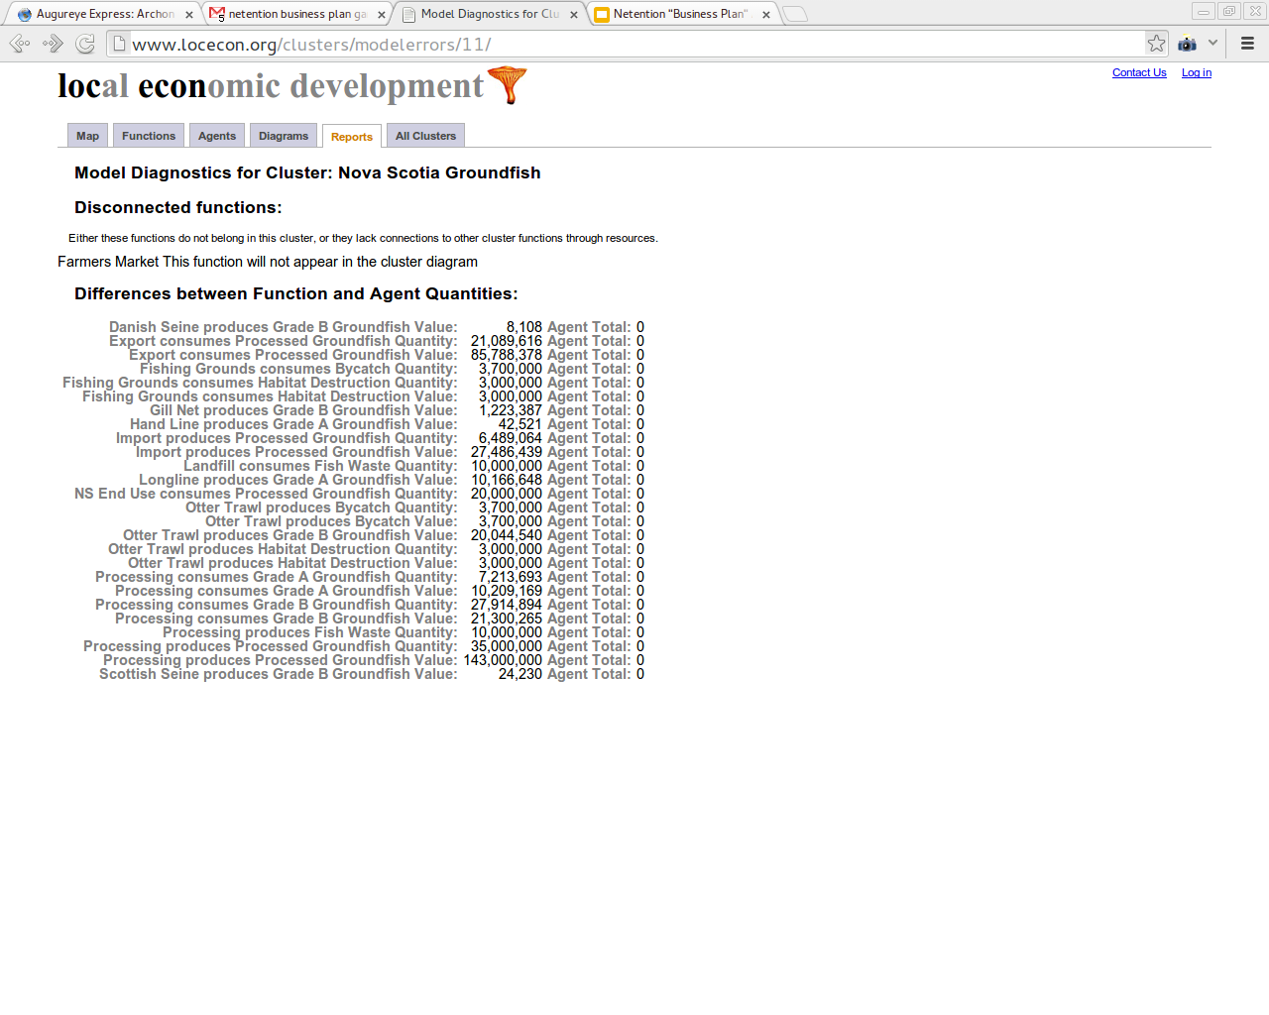

Slide 31
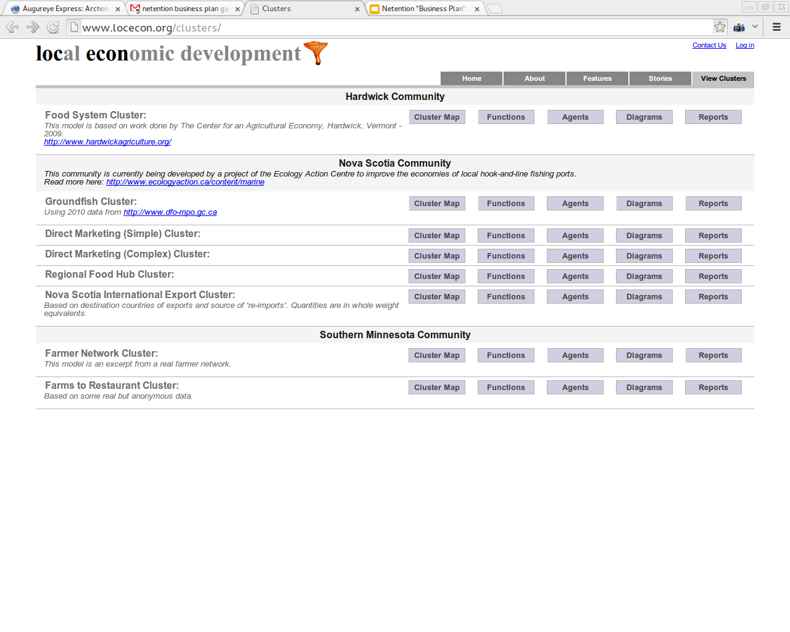

Slide 32
REA Enterprise Ontology
Value System and Value Chain Modeling
Resources
Events
Agents

Slide 33
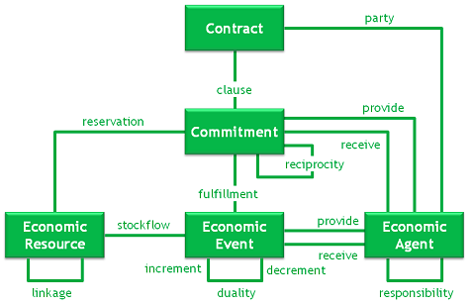

Slide 34
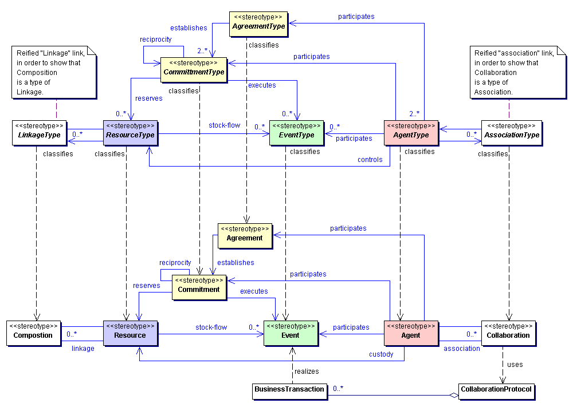
Want/Need -> Offer/Agreement -> Commitment(=Potential Event)

